Slide 1
UTILIZATION OF IMAGES FOR MONITORING OF PROGRESS OF CONSTRUCTION ACTIVITIES FOR BUILDING CONSTRUCTION PROJECTS
CSE7101- Capstone Project
Review-1
Batch Number:ISE_05
Roll Number | Student Name
Under the Supervision of,
Dr . Zafar Ali Khan
Professor
School of Computer Science and Engineering
Presidency University
20221ISE0025 | GAGANA S R
20221ISE0021 | TANUSHREE M S
20221ISE0042 | SNEHA KUMARI
Name of the Program: B. Tech Information Science Engineering(Robotics)
Name of the HoD: Dr. Zafar Ali Khan
Name of the Program Project Coordinator: Ms. Suma N G
Name of the School Project Coordinators: Dr. Sampath A K, Dr. Geetha A

Slide 2
Content
Problem Statement
Objectives
Background and Related work for title Selection
Analysis of Problem Statement
Innovation or Novel Contributions
GitHub Link
Timeline of the Project
References

Slide 3
Problem Statement Number:
Organization: Presidency University
Category (Hardware / Software / Both) : Software
Problem Description: Monitoring the progress of building construction projects is often challenging due to the reliance on manual inspections and subjective reporting, which can lead to delays and errors. By systematically collecting and analyzing images, project managers can create visual progress records, compare actual work with planned schedules, generate quantitative progress metrics, and detect delays or quality issues early. This approach improves transparency, reduces the need for frequent site visits, and enhances decision-making, ultimately leading to more efficient project management.
Expected output: Accurate visual records and measurable insights on construction progress, enabling early issue detection, reduced manual monitoring, and improved project management efficiency.

Slide 4
Objectives
To design and develop a software system that uses site images to monitor and evaluate the progress of construction activities.
To automate the comparison of planned versus actual progress with image data.
To provide visual dashboards and reports for project managers and stakeholders.
To reduce manual effort, errors, and delays in construction monitoring.
To improve decision-making and transparency in construction projects.

Slide 5
Background and Related work for title Selection
Background
Monitoring progress in building construction projects has traditionally relied on manual inspections, site reports, and stakeholder meetings. While these methods provide necessary updates, they are often time-consuming, subjective, and prone to errors, which can result in delays, cost overruns, and miscommunication. With the increasing complexity of modern construction projects, there is a need for more accurate, real-time, and objective progress tracking methods. The integration of digital technologies, especially image-based monitoring through cameras, drones, and mobile devices.
Related Work
In recent years, several studies and industry applications have explored the use of image-based techniques for construction monitoring. Researchers have applied computer vision and photogrammetry to analyze site images for identifying completed structural components and estimating work progress. Other related works have integrated artificial intelligence and deep learning techniques to classify construction activities and detect safety risks automatically. These advancements demonstrate the potential of image utilization as a reliable, scalable, and cost-effective method for progress monitoring in construction projects.

Slide 6
Analysis of Problem Statement (contd...)
-Current Challenges
> Manual monitoring causes delays and bias in reporting.
> There are no real-time updates for stakeholders.
> It is hard to keep accurate documentation of progress.
> Disagreements arise from differences between reported and actual work.
-Opportunities with Image Use
> Site images can be processed and analyzed automatically.
> Image-based progress tracking gives visual proof.
> Using AI/ML can help find completed and pending tasks.
> Digital records improve project transparency and cut down on disputes.

Slide 7
Analysis of Problem Statement (contd...)
-Scope of the Solution
>Take images of construction sites at regular intervals.
>Analyze images to identify progress (e.g., wall completion, flooring, structure).
>Store and compare progress against project schedules.
>Create reports and alerts for project managers.

Slide 8
Innovation or Novel Contributions
The proposed project introduces a software-based image monitoring system with the following innovative aspects:
Affordable & Accessible – Unlike high-cost BIM or drone solutions, the system is designed as a low-cost software tool accessible to small and medium construction firms.
Automated Progress Tracking – Uses image processing to automatically compare site progress with planned schedules.
Visual Evidence Reporting – Generates dashboards and reports enriched with visual proof (before/after images).
Integration with Databases – Stores progress history for transparency, reducing disputes among stakeholders.
Scalable & Extensible – Can be enhanced with AI/ML models for object detection (e.g., detecting completed structural components).

Slide 9
Github Link
Github Link
https://github.com/Tanushreems/Utilization-of-images-for-monitoring-of-progress-of-construction-activities.git

Slide 10
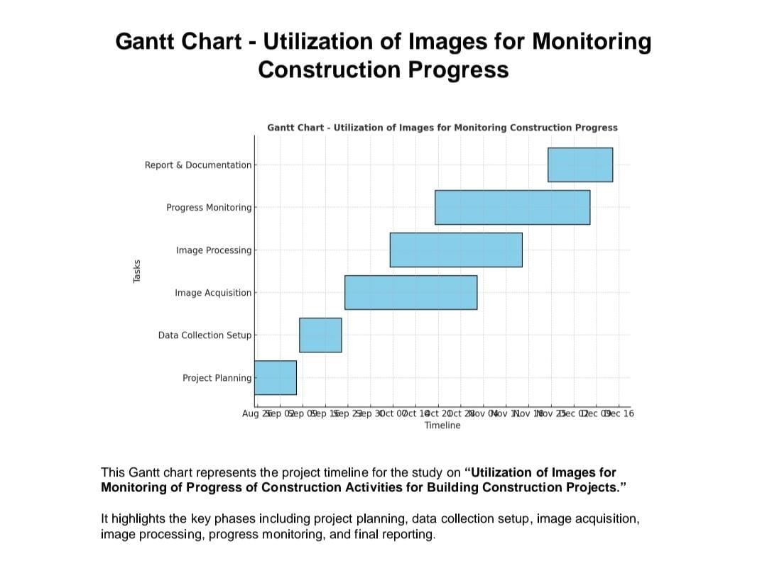
Timeline of the Project (Gantt Chart)

Slide 11
References (IEEE Paper format)
[1] H. Yang, C. Li, Z. Zhang, and Z. Huang, “Computer vision for construction progress monitoring: A real-time object detection approach,” arXiv preprint arXiv:2305.15097, 2023.
[2] N. Mahami, A. Mahami, and F. Zafari, “Material recognition for automated progress monitoring using deep learning methods,” arXiv preprint arXiv:2006.16344, 2020.
[3] A. Becker, M. Mukadam, and S. Scherer, “3D coverage path planning for efficient construction progress monitoring,” arXiv preprint arXiv:2302.00968, 2023.
[4] K. Karsch, H. Golparvar-Fard, and D. Forsyth, “ConstructAide: Analyzing and visualizing construction sites through photographs and building models,” arXiv preprint arXiv:1912.11567, 2019.

Slide 12


